Slide 1
Texas Workforce Commission Civil Rights Division (“CRD”)
Reasonable Accommodations and Accessibility Training

Slide 2
Fair Housing Webinar Series
April 4 from 1:30-3:00pm: Fair Housing Overview
April 11 from 1:30-3:00pm: Reasonable Accommodations and Accessibility
Webinar information located at https://www.tdhca.state.tx.us/fair-housing/announcements.htm or the calendar portion of TDHCA’s website.
For further information, please contact Suzanne Hemphill, TDHCA Fair Housing Project Manager at suzanne.hemphill@tdhca.state.tx.us

Slide 3
Presenters
Texas Department of Housing & Community Affairs (“TDHCA”)
Texas Workforce Commission, Civil Rights Division (“CRD”)
Vickie Covington
Senior Investigator & Outreach Coordinator
Vickie.Covington@twc.state.tx.us
512-463-2642
Suzanne Hemphill
Fair Housing Project Manager
Suzanne.Hemphill@tdhca.state.tx.us
512-475-4595

Slide 4
Mission and Vision of CRD
Our mission is to reduce discrimination in employment and housing through education and enforcement of state and federal laws.
Our vision is to help create an environment in which citizens of the State of Texas may pursue and enjoy the benefits of employment and housing that are free from discrimination.

Slide 5
Agenda
Objectives
Purpose of the Fair Housing Act and the Texas Fair Housing Act
Reasonable Accommodations
Case Scenarios
Other Accessibility Issues
Mediation

Slide 6
Objectives
Identify the Purpose of the Acts
Reasonable Accommodations
Define Disability
Recognize a Request for Reasonable Accommodations
Recognize Appropriate Responses to a Request for Reasonable Accommodations
Identify Resources
Identify Other Accessibility Issues

Slide 7
Purpose
The purpose of the Fair Housing Act is to, within constitutional limitations, provide for fair housing throughout the United States.
The purpose of the Texas Fair Housing Act is to:
Provide for fair housing practices in the state
Create a procedure for investigation and settling complaints
Provide rights and remedies substantially equivalent to federal law

Slide 8
Protected Classes
Race
Color
National Origin
Familial Status
Religion
Sex
Disability

Slide 9
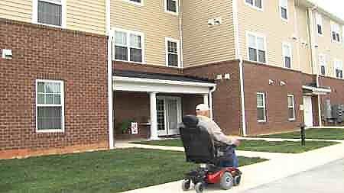
Purpose of the Disability Protected Class
Give people with disabilities greater freedom to choose where they will live and greater freedom to visit friends and relatives.
Proactively address the needs
of an evolving population.
Look ahead at future needs.
Allow people to remain in and safely use their dwellings longer.

Slide 10
Disability
How Is Disability Defined?
Under the Acts Any person who has a physical or mental impairment that substantially limits one or more major life activities;
Or has a record of such an impairment;
Or is regarded as having an impairment.
Note: 504 and ADA have slightly different definitions.

Slide 11
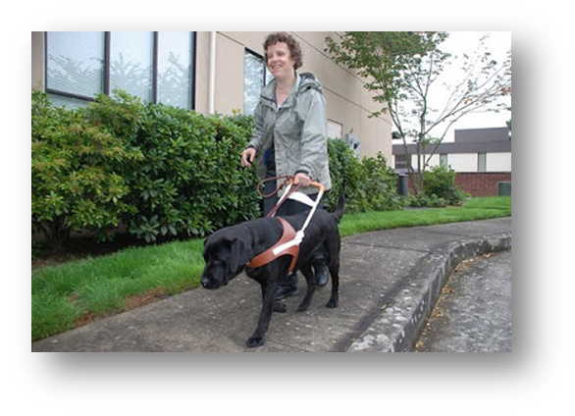
Disability
What are some major life activities?
Seeing
Hearing
Breathing
Walking
Performing manual tasks
Caring for one's self
Learning
Speaking
Working-broad class of jobs

Slide 12
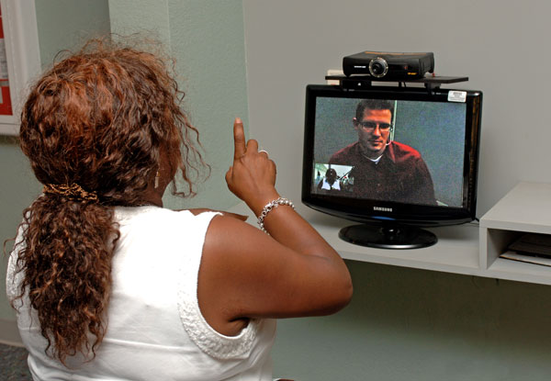
Disability
What are some examples of impairments which may result in a disability?
Visual, speech, and hearing impairments
Cerebral palsy
Autism
Epilepsy
Muscular dystrophy
Multiple sclerosis
Cancer
Heart disease
Diabetes
Human Immunodeficiency Virus (HIV) infection
Drug addiction (other than addiction caused by current, illegal use of a controlled substance)
Alcoholism

Slide 13
What is a Reasonable Accommodation?
A change, exception, or adjustment in rules, policies, practices, or services necessary to afford a person with a disability equal opportunity to use and enjoy the dwelling.

Slide 14
Why grant a reasonable accommodation?
Because policies, practices, and services may have a different effect on persons with disabilities than on other persons
Treating persons with disabilities exactly the same as others will sometimes deny them an equal opportunity to use and enjoy a dwelling.

Slide 15
What do state and federal laws require?
Housing providers to make reasonable accommodations to the rules, policies, practices, or services, when such accommodations may be necessary to afford persons with disabilities an equal opportunity to use and enjoy a dwelling.

Slide 16
Reasonable Accommodations Example 1
A housing provider has a policy of providing unassigned parking spaces to residents. A resident with a mobility impairment, who is substantially limited in her ability to walk, requests an assigned accessible parking space close to the entrance to her unit as a reasonable accommodation. There are available parking spaces near the entrance to her unit that are accessible, but those spaces are available to all residents on a first come, first served basis.

Slide 17
Reasonable Accommodation Request Guidelines
The requester must make the request in a manner that a reasonable person would understand to be a request for an exception, change, or adjustment to a rule, policy, practice, or service because of a disability.
The request does not have to be made in writing or on a certain form.
An individual making a reasonable accommodation request does not need to mention the Acts or use the words "reasonable accommodation” or use any magic words.
The request can be made by a family member or someone else who is acting on the person’s behalf.

Slide 18
What inquiries can I make if a resident asks for a Reasonable Accommodation?
A housing provider may ask for information relevant to determining if a requested reasonable accommodation is necessary because of a disability.
For a disability that is not obvious or the need is not obvious, a housing provider may request reliable disability-related information that
(1) is necessary to verify that the person meets the Acts’ definition of disability;
(2) describes the needed accommodation; and
(3) shows the relationship (or nexus) between the person’s disability and the need for the requested accommodation.
A doctor or other medical professional, a peer support group, a non-medical service agency, or a reliable third party who is in a position to know about the individual's disability may also provide verification of a disability.

Slide 19
Reasonable Accommodations Example 2
A rental applicant who uses a wheelchair advises a housing provider that she wishes to keep an assistance dog in her unit even though the provider has a "no pets" policy. The applicant’s disability is readily apparent but the need for an assistance animal is not obvious to the provider. The housing provider may ask the applicant to provide information about the disability-related need for the dog.

Slide 20
What can’t I ask? Reasonable Accommodations
A housing provider may not ordinarily ask the following:
The nature and severity of an individual's disability.
If an applicant has a disability or if a person intending to reside in a dwelling or anyone associated with an applicant has a disability.
Examples of exceptions:
If the housing provider offers accessible units to persons with disabilities needing the features of these units on a priority basis.
If the housing provider operates housing that is legally limited to persons with a specific diagnosis, such as chronic mental illness.

Slide 21
What should I do when I receive a request?
Review and ensure your reasonable accommodations policy is consistent with the Acts and the HUD/DOJ Memorandum on Reasonable Accommodations.
Accept verbal requests.
Engage in the interactive process with the requestor.
If the disability is not obvious or the need is not obvious, ask for appropriate reliable disability-related information.
Provide prompt responses to reasonable accommodation requests.
Document your actions.
Note: An undue delay in responding to a reasonable accommodation request may be deemed to be a failure to provide a reasonable accommodation.

Slide 22
Back to Reasonable Accommodations Example 1
“A housing provider has a policy of providing unassigned parking spaces to residents. A resident with a mobility impairment, who is substantially limited in her ability to walk, requests an assigned accessible parking space close to the entrance to her unit as a reasonable accommodation. There are available parking spaces near the entrance to her unit that are accessible, but those spaces are available to all residents on a first come, first served basis.”
What should the housing provider do?
The housing provider should make an exception to its policy of not providing assigned parking spaces to accommodate this resident.

Slide 23
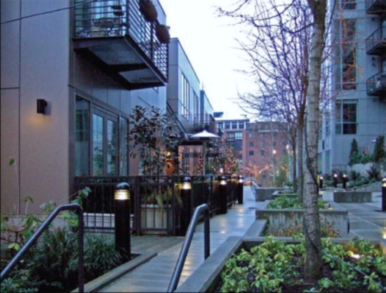
Other Accessibility Issues
Reasonable Modifications
Design and Construction
Terms, conditions or privileges for sale or rental of a dwelling and provision of housing services or facilities

Slide 24
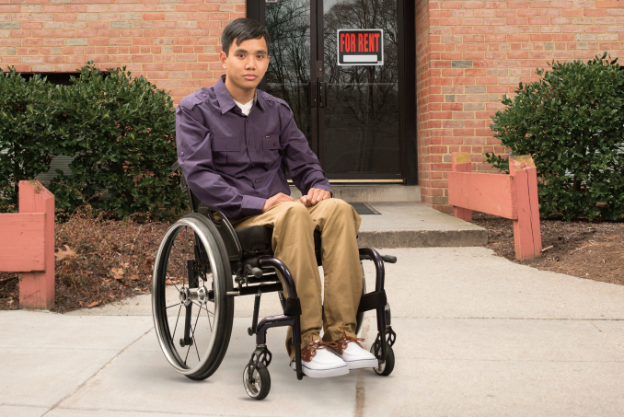
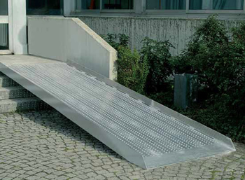
Issue: Reasonable Modification
If a person is disabled…
….a landlord cannot refuse to let that person make reasonable modifications to the person’s dwelling or common use areas, at that person’s own expense (unless 504 applies), if necessary for that person to use the housing.

Slide 25
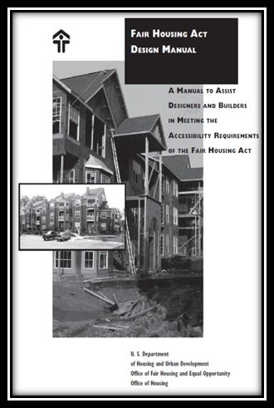
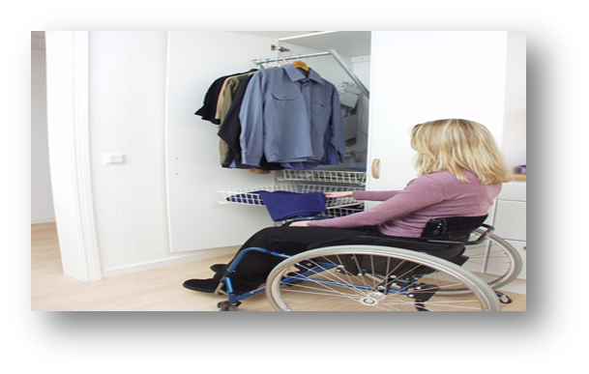
Issue: Design & Construction Requirements
For all covered multifamily dwellings that were built for first
occupancy after March 13, 1991, they have to be designed
and constructed in a manner that is accessible and usable.
Requirements
Accessible building entrance on an accessible route into and through the dwelling.
Accessible public and common use areas
Doors that allow (wheelchair) passage into
and within all rooms
Accessible route into and through
each covered unit

Slide 26
Issue: Design & Construction Requirements
Requirements (Cont’d)
Light switches, electrical outlets, thermostats and other environmental controls in accessible locations.
Reinforcements in bathroom walls so grab bars can be added when needed.
Usable kitchens and bathrooms so that an individual in a wheelchair can maneuver about the space.

Slide 27
Who pays?
Housing providers may claim undue financial and administrative burden or that the requested reasonable accommodation constitutes a fundamental alteration of the provider’s operations, so the following would be considerations:
The financial resources of the provider.
The cost of the reasonable accommodation.
Benefits to the requester of the requested accommodation.
The availability of other, less expensive alternative accommodations that would effectively meet the applicant or resident’s disability-related needs.
The Fair Housing Act provides that while the housing provider must permit the reasonable modification, the tenant is responsible for paying the cost of the modification. However, …..

Slide 28
Questions to Determine Who Pays for Modifications
Is it a single-family or multi-family dwelling unit?
Does the property receive federal financial assistance?
When was the property built for first occupancy?
Does the property participate in the Low-Income Housing Tax Credit Program?
What type of accessibility feature is being requested?
Does an agreement exist between the parties?
Source: Fair Housing Council of Greater San Antonio

Slide 29
Implications for Properties Subject to Section 504
Under the regulations implementing Section 504 of the Rehabilitation Act of 1973, structural changes needed by an applicant/resident with a disability in housing receiving federal financial assistance are considered reasonable accommodations and must be paid for by the housing provider in most cases.
All participants in TDHCA’s Low-Income Housing Tax Credit Program, awarded after 2001 are required to provide and pay for reasonable accommodations including structural modifications to dwelling units or public and common-use areas if they do not amount to an undue financial and administrative burden.
Source: Fair Housing Council of Greater San Antonio

Slide 30
Reasonable Modifications Flowchart – Who Pays?
Source: Fair Housing Council of Greater San Antonio
NOT LIHTC AWARDED AFTER 2001
YES LIHTC AWARDED AFTER 2001

Slide 31
Reasonable Accommodations Example 3
Because of his disability, an applicant with a hearing impairment needs to keep an assistance animal in his unit as a reasonable accommodation. The housing provider may not require the applicant to pay a fee or a security deposit as a condition of allowing the applicant to keep the assistance animal. However, if a tenant's assistance animal causes damage to the applicant's unit or the common areas of the dwelling, the housing provider may charge the tenant for the cost of repairing the damage (or deduct it from the standard security deposit imposed on all tenants), if it is the provider's practice to assess tenants for any damage they cause to the premises.

Slide 32
Reasonable Accommodations
When can I deny a request for a reasonable accommodation?
If the housing provider has reliable, objective evidence that a person with a disability poses a direct threat to others.
If the request was not made by or on behalf of a person with a disability or if there is no disability related need for the accommodation.
If providing the accommodation is not reasonable – i.e., if it would impose an undue financial and administrative burden on the housing provider or it would fundamentally alter the nature of the provider's operations.
If not reasonable, consider whether there is an alternative accommodation that would effectively address the requester's disability-related needs.
Note: A "fundamental alteration" is a modification that alters the essential nature of a provider's operations.

Slide 33
Reasonable Accommodations Example 4
A tenant has a severe mobility impairment that substantially limits his ability to walk. He asks his housing provider to transport him to the grocery store and assist him with his grocery shopping as a reasonable accommodation to his disability. The provider does not provide any transportation or shopping services for its tenants, so granting this request would require a fundamental alteration in the nature of the provider's operations. The request can be denied, but the provider should discuss with the requester whether there is any alternative accommodation that would effectively meet the requester's disability-related needs without fundamentally altering the nature of its operations, such as reducing the tenant's need to walk long distances by altering its parking policy to allow a volunteer from a local community service organization to park her car close to the tenant's unit so she can transport the tenant to the grocery store and assist him with his shopping.

Slide 34
Case Scenario – A
Complainant Organization, Inc. tested the ABC Apartments. The tester identified herself as a person with disabilities who needed a service animal so she would be afforded an equal opportunity to use and enjoy a dwelling. Tester stated that she had a prescription from her doctor showing the need for the service animal. Respondents would not accept the prescription and stated that the animal exceeded their weight limits.
Respondents required the tester to present documentation that her 60lb Pitbull service animal was registered. The tester requested that the requirements be waived for her service animal and respondents stated that the requirements could not be waived.
Complainant Organization, Inc. alleged that the tester was denied the reasonable accommodation request to waive this discriminatory process.

Slide 35
Case Scenario - B
Complainant alleged that Respondent’s manager and assistant manager asked her to give them $300 for a pet deposit for her emotional support cat and also to pay a monthly pet fee of $10. They also threatened to send a lease violation notice to the housing authority. Complainant alleged the manager was aware of her disability. The manager asked Complainant to come to the office and when she went to the office, the manager told her to sign an animal addendum for her cat.
Complainant alleged that she was subjected to different terms and conditions of rental, and denied a reasonable accommodation due to her disability.

Slide 36
Case Scenario - C
Complainant is a person with disabilities which prevent him from walking and talking and Complainant uses a wheelchair. Complainant lived with his brother, who had a general power of attorney which allowed the brother to act on Complainant’s behalf. Complainant’s brother purchased a wheelchair carrier in order to safely transport Complainant and his wheelchair. The brother parked the wheelchair carrier in his driveway in front of his home. However, the Home Owners Association (“HOA”) demanded that he remove the wheelchair carrier, citing a deed restriction.
Complainant alleged the HOA failed to make a reasonable accommodation of allowing an exception to the deed restriction when the HOA disapproved his request to keep the wheelchair carrier in the driveway.

Slide 37
Case Scenario - D
Complainant alleged she was subjected to different terms, conditions, privileges, or services and facilities and denied a reasonable accommodation request because of her disabilities.
She stated that the Respondent manager's representative and the staff at the Apartments discriminated against her by denying her reasonable accommodation request to be allowed to pay her rent according to the day she receives her Social Security Disability Income check. Her check arrives the third Wednesday of every month. Complainant alleged that instead she received numerous late fees which have put her in a financial bind.

Slide 38
Reasonable Accommodations Investigative Elements
When TWCCRD investigates cases involving reasonable accommodations, these are the elements of proof:
Does the resident or applicant have a disability?
Did the housing provider know or reasonably should have known that the resident or applicant is a person with a disability?
Did the resident or applicant request a reasonable accommodation in the rules, policies, practices, or services of the housing provider?
Was the requested accommodation necessary to afford the resident or applicant an equal opportunity to use and enjoy the dwelling?
Did the housing provider refuse the resident’s or applicant’s request to make such accommodation or fail to respond or delay responding to the request such that it amounted to a denial.

Slide 39
Issue: Terms and Conditions
It is illegal to set different terms, conditions or privileges for sale or rental because of disability.
Examples:
Housing providers may not treat disabled tenants differently when it comes to issuing lease violation notices because of the disability of the person.
Housing providers may not require disabled persons to sign an extra addendum to use the pool at the property.

Slide 40
Other Disability Laws
ADA-limits definition of service animal to “dog”; does not include emotional support animals
The dog has to be individually trained
Applies to state and local governments
Inquiries are limited to 1) is the service animal required because of a disability and 2) what work or tasks has the animal been trained to perform
Entities cannot request documentation
504-includes emotional support and assistance animals; not considered pets
Animals are not required to be trained or certified
May accompany the person in all areas of the premises
Breed, size, and weight limits may not be applied
Owners are responsible for the costs of reasonable accommodations or modification in most cases

Slide 41
TDHCA Accessibility
10 TAC Rule § 1.204, Reasonable Accommodations
“A Recipient that owns a LIHTC or Multifamily Bond Development with no federal or state funds awarded before September 1, 2001 must allow but may not need to pay for the Reasonable Accommodation, except if the accommodation requested should have been made as part of the original design and construction requirements under the Fair Housing Act, or is a Reasonable Accommodation identified by the U.S. Department of Justice with a de minimis cost (e.g., assigned parking spot, no deposit for service/assistance animals, etc).
In general, denial of reasonable accommodations often occurs due to misunderstandings of what reasonable accommodations are and how they work.

Slide 42
TDHCA Reasonable Accommodations
10 TAC Rule § 1.204, Reasonable Accommodations
(b) Responses to Reasonable Accommodation requests must be provided within a reasonable amount of time, not to exceed 14 calendar days. The response must either be to grant the request, deny the request, offer alternatives to the request, or request additional information to clarify the Reasonable Accommodation request. Should additional information be required and an interactive process is necessary, this process must also be completed within a reasonable amount of time. An undue delay in responding to a reasonable accommodation request may be a failure to provide a reasonable accommodation.

Slide 43
TDHCA Reasonable Accommodations - Examples
A resident requests to move their rent due date to coincide with their social security disability check. It would not be considered reasonable to wait 14 calendar days to respond to this request.
A resident requests a designated accessible parking space. An individual's Disability status and the connection to the Reasonable Accommodation request are not clear. Documentation must be requested within 14 calendar days to clarify the resident's request, engaging in an interactive process to determine the nature of the request and the needs of the resident.
An applicant with a Disability requires a service animal to alert of impending seizures. The shelter has a no pets policy. It would not be reasonable to wait 14 calendar days to respond to this request.

Slide 44
TDHCA Reasonable Accommodations - Examples
A person with a Disability requests modifying door knobs to levers. The property must respond to the request within 14 calendar days, although it is reasonable that it may take additional time to install the modified door knobs.
A housing provider requires that tenants sign 12 month leases. A household signs the lease, but after a few months has to move out in order to live in a nursing home. The household requests a reasonable accommodation to be let out of his lease early without a fee. The property may request additional information if the Disability and relationship between the request is not clear, but must ask for this information within 14 calendar days.
An applicant requests a reasonable accommodation to have assistance in filling out a program application for the Housing Trust Fund Program. It would not be reasonable to wait 14 calendar days to respond to this request.

Slide 45
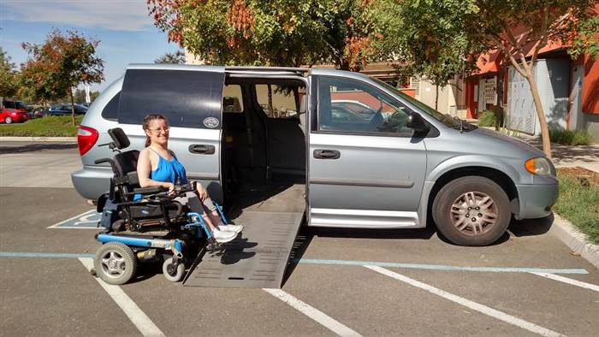
TDHCA Accessibility - Examples
A resident requires an accessible parking space that will accommodate her wheelchair-equipped van.
A Reasonable Accommodation includes relocating and enlarging an existing parking space that will serve the van.

Slide 46
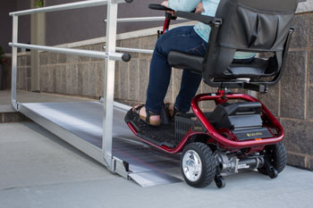
TDHCA Accessibility - Examples
A resident uses a scooter type wheelchair which is 38 inches in width. She requests a ramp to enter her ground floor unit. The ramp which she requests must be at least 40 inches wide, it must have a slope of no more than 3%, and the landing at the front door, which opens outward, must be enlarged to provide adequate maneuvering space to enter the doorway. The changes must be provided, even though they may exceed the usual specifications for such alterations.

Slide 47
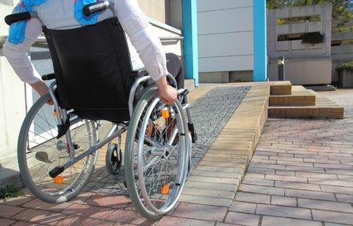
TDHCA Accessibility - Example
A resident needs a ramped entrance to her ground floor unit to accommodate her wheelchair. She does not wish to move to an accessible unit. The Recipient must provide an accessible entrance at the resident's current unit, unless it would be an undue financial and administrative hardship or a fundamental alteration of the program to do so.

Slide 48
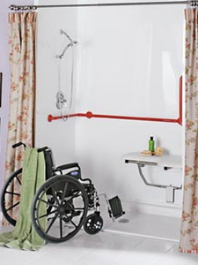
TDHCA Accessibility - Examples
A resident with quadriplegia requests replacement of a bathtub in his unit with a roll-in shower. Due to the location of existing plumbing in the building and the size of the existing bathroom, a plumber confirms that installation of a roll-in shower in that unit is impossible. The on-site manager should meet with the resident to explain why the roll-in shower cannot be installed and to explore alternative accommodations with the resident.

Slide 49
Complaints
Property Management – if you have a complaint filed against you:
You will be notified of the allegations
You likely will be invited to mediate
If you decide not to mediate, you may file an answer that is
In writing
Under penalty of perjury
May be amended at any time
Complainant – if you need to file a complaint:
Go to: texasworkforce.org/civilrights
Fill out the electronic form

Slide 50
Mediation
Free service offered from the time of the complainant filing until resolved
Eliminates lengthy investigations and expensive litigation
Speedy resolution of complaints
Saves time and money
Opens lines of communication between disputing parties
Allows each party to understand the position of an opposing party
The agreement is binding on both the Complainant and the Respondent

Slide 51
TWCCRD Trends by Protected Class FY 2016
Basis | Number | Percentage
Disability | 567 | 77%
Race | 127 | 17%
Sex | 19 | 3%
Familial Status | 28 | 4%
National Origin | 43 | 6%
Color | 0 | 0%
Retaliation | 19 | 3%
Religion | 7 | 1%
TOTAL FILED* | 741 | N/A

Slide 52
TWCCRD Trends by Issue FY 2016
Issue | Number | Percentage
Terms and Conditions | 592 | 80%
Refusal to Rent | 142 | 20%
Refusal to Sell | 4 | 1%
Discriminatory Financing | 6 | 1%
Discriminatory Advertising | 41 | 6%
False Representation | 11 | 2%
Intimidation/Interference | 126 | 17%
Reasonable Accommodation | 512 | 69%
Reasonable Modification | 8 | 1%
Other | 20 | 3%
TOTAL FILED* | 741 | N/A

Slide 53
What Can Housing Providers do?
Get Educated—know the law; know your responsibilities
Establish policies and procedures that are non-discriminatory
Implement non-discriminatory policies and procedures and consistently apply them (absent a reasonable request for accommodation/modification)
Recognize a request for reasonable modification/accommodation
Document reasonable accommodation interactions

Slide 54
What Housing Consumers do?
Get Educated—know the law; know your rights
Read and be familiar with the lease, addendums and other Housing Provider information concerning tenancy/residency; comply with the terms of the lease
Document interactions with Housing Providers
File a Fair Housing Complaint

Slide 55
Questions?
Please sign up for the Civil Rights Reporter at: http://www.twc.state.tx.us/partners/civil-rights-reporter

Slide 56
Training & Technical Assistance
Contact the Texas Workforce Commission
Civil Rights Division at:
(888) 452-4778 or (512) 463-2642
crdtraining@twc.state.tx.us

