Slide 1
Texas Workforce Commission Civil Rights Division (“CRD”)
Fair Housing Overview
Training

Slide 2
Fair Housing Webinar Series
April 4 from 1:30-3:00pm: Fair Housing Overview
April 11 from 1:30-3:00pm: Reasonable Accommodations and Accessibility
Webinar information located at https://www.tdhca.state.tx.us/fair-housing/announcements.htm or the calendar portion of TDHCA’s website.
For further information, please contact Suzanne Hemphill, TDHCA Fair Housing Project Manager at suzanne.hemphill@tdhca.state.tx.us

Slide 3
Presenters
Texas Department of Housing & Community Affairs (“TDHCA”)
Texas Workforce Commission, Civil Rights Division (“CRD”)
Vickie Covington
Senior Investigator & Outreach Coordinator
Vickie.Covington@twc.state.tx.us
512-463-2642
Suzanne Hemphill
Fair Housing Project Manager
Suzanne.Hemphill@tdhca.state.tx.us
512-475-4595

Slide 4
Agenda
Training Objectives
Purpose of the Federal Fair Housing Act and the Texas Fair Housing Act (the Acts)
Mission and Vision of CRD
Covered/Protected Classes
Issues/Discriminatory Practices
HUD Disparate Impact Guidance
Exemptions
Fair Housing Testing
Mediation
Resources

Slide 5
Objectives
Identify the Purpose of the Federal Fair Housing Act and Texas Fair Housing Act
Recognize Covered/Protected Classes
Recognize Issue/Discriminatory Practices
Identify Exemptions per the Acts
Introduction to Fair Housing Testing

Slide 6
Mission and Vision of CRD
Our mission is to reduce discrimination in employment and housing through education and enforcement of state and federal laws.
Our vision is to help create an environment in which citizens of the State of Texas may pursue and enjoy the benefits of employment and housing that are free from discrimination.

Slide 7
Texas Fair Housing Act
The purpose of the Federal Fair Housing Act is to, within constitutional limitations, provide for fair housing throughout the United States.
The purpose of the Texas Fair Housing Act is to:
Provide for fair housing practices.
Create a procedure for investigation and settling complaints.
Provide rights and remedies substantially equivalent to federal law.

Slide 8
Protected Classes/Bases
Race
Color
National Origin
Familial Status
Religion
Sex
Disability

Slide 9
Protected Class: Race
Asian
African American or Black
Native American or Alaska Native
Native Hawaiian or Other Pacific Islander
White

Slide 10
Protected Class: Color
Pigmentation of the skin

Slide 11
Protected Class: National Origin
Ancestry
Birthplace
Ethnic Background
Limited English Proficiency
(LEP): Refers to a person’s limited ability to read, write, speak, or understand English…can also be race discrimination

Slide 12
Protected Class: Familial Status
Includes persons who are:
Pregnant
Parent/Legal custodian of child living with them who is under 18.
Securing custody of a child
Example:
“You can’t rent that unit – families aren’t allowed in that building because older residents don’t want children there.”

Slide 13
Protected Class: Religion
Overt discrimination against members of particular religion
Indirect discrimination such as zoning to limit use of private homes as places of worship

Slide 14
Protected Class: Sex
Sexual Harassment
Gender Stereotyping
Discriminatory Pricing because of pregnancy
Note: Respondents’ staff including maintenance personnel, may be named as a Respondent where sexual harassment is alleged.

Slide 15
Protected Class: Disability
Disability means:
A mental or physical impairment that substantially limits at least one major life activity.
A record of an impairment.
Being regarded as having an impairment.

Slide 16
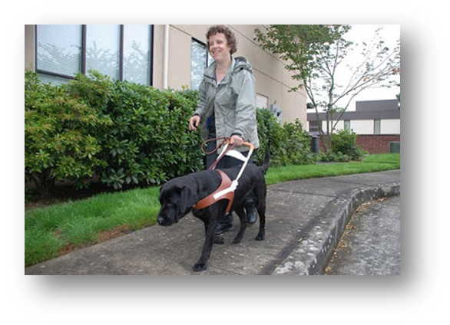
Protected Class: Disability
What are some major life activities?
Seeing
Hearing
Breathing
Walking
Performing manual tasks
Caring for one's self
Learning
Speaking
Working-broad class of jobs

Slide 17
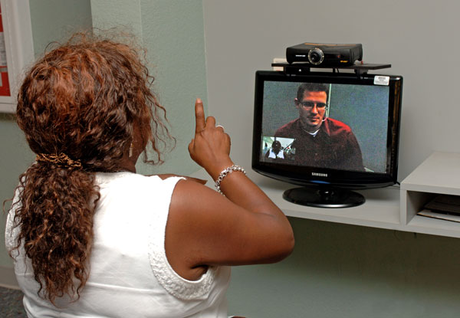
Protected Class: Disability
What are some examples of impairments which may result in a disability?
Visual, speech, and hearing impairments
Cerebral palsy
Autism
Epilepsy
Muscular dystrophy
Multiple sclerosis
Cancer
Heart disease
Diabetes
Human Immunodeficiency Virus (HIV) infection
Drug addiction (other than addiction caused by current, illegal use of a controlled substance)
Alcoholism

Slide 18
Issues/Discriminatory Practices
Major Categories:
Specific prohibitions that apply only to people who are disabled
Reasonable Modification
Reasonable Accommodation
Design and Construction
Practices involving sale or rental
Terms and conditions
Making discriminatory statements
Inspection
Entry into a neighborhood
Discriminatory lending practices
Prohibited conduct relating to brokerage services
Retaliation

Slide 19
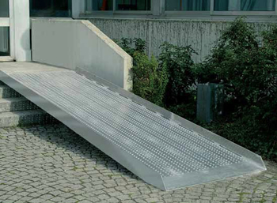
Issue: Reasonable Modification
First specific prohibition if a person is disabled…
…a landlord cannot refuse to let that person make reasonable modifications to the person’s dwelling or common use areas, at that person’s own expense, if necessary for that person to use the housing.
Example:
“A wheelchair ramp can’t be installed there,
so you can’t live in this complex.”

Slide 20
Issue: Reasonable Accommodation
Second specific prohibition if a person is disabled…
…a landlord cannot refuse to make a reasonable accommodation in the rules, the policies, the practices, or the services if the accommodation is necessary for the person with a disability to use the housing.
Example:
“You must pay all pet fees and rent, even though you have a service animal.”

Slide 21
Reasonable Accommodation Scenario
“A housing provider has a policy of providing unassigned parking spaces to residents. A resident with a mobility impairment, who is substantially limited in her ability to walk, requests an assigned accessible parking space close to the entrance to her unit as a reasonable accommodation. There are available parking spaces near the entrance to her unit that are accessible, but those spaces are available to all residents on a first come, first served basis.”
What should the housing provider do?

Slide 22
Reasonable Accommodation Scenario
The housing provider should make an exception to its policy of not providing assigned parking spaces to accommodate this resident.

Slide 23
Case Scenario 1
Allegation:
The Complainant uses a wheelchair, and at times, a walker.
She alleges that she was denied a reasonable accommodation.
The Complainant was issued a disabled parking space without a curb cut and was told she would be charged for the installation of a curb cut. The complex then charged her for it.
The Complainant also was given a unit that required negotiation of a step.

Slide 24
Reasonable Accommodation Scenario
Because of his disability, an applicant with a hearing impairment needs to keep an assistance animal in his unit as a reasonable accommodation.
The housing provider may not require the applicant to pay a fee, pet rent, or a pet security deposit as a condition of allowing the applicant to keep the assistance animal. However, if a tenant's assistance animal causes damage to the tenant's unit or the common areas of the dwelling, the housing provider may charge the tenant for the cost of repairing the damage (or deduct it from the standard security deposit imposed on all tenants), if it is the provider's practice to assess tenants for any damage they cause to the premises.

Slide 25
Case Scenario 2
Allegation:
Complainant Organization, Inc. tested the ABC Apartments. The tester identified herself as a person with disabilities who needed a service animal so she would be afforded an equal opportunity to use and enjoy a dwelling. Tester stated that she had a prescription from her doctor showing the need for the service animal. Respondents would not accept the prescription and stated that the animal exceeded their weight limits.
Respondents required the tester to present documentation that her 60 pound Pitbull service animal was registered. The tester requested that the requirements be waived for her service animal and respondents stated that the requirements could not be waived.
Complainant Organization, Inc. alleged that the tester was denied the reasonable accommodation request to waive ABC Apartments’ discriminatory process.

Slide 26
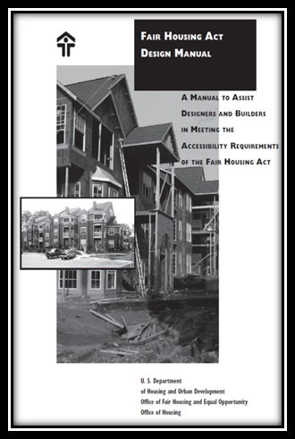
Issue: Design & Construction
Third specific prohibition if a person is disabled…
For all covered multifamily dwellings that were built for first occupancy after March 13, 1991 they have to be designed and constructed in a manner that is:
Accessible
Usable

Slide 27
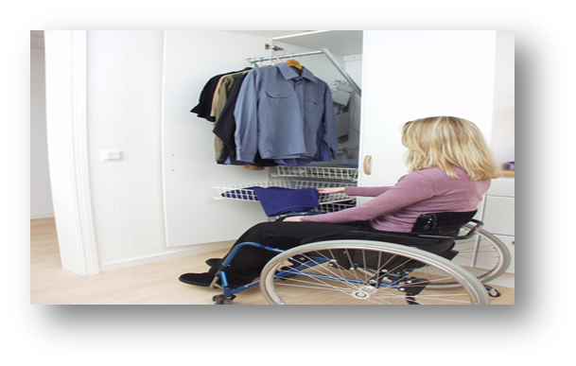
Issue: Design & Construction Requirements
Requirements
Accessible building entrance on an accessible route into and through the dwelling.
Accessible public and common use areas.
Doors that allow (wheelchair) passage into and within all rooms.
Accessible route into and through each covered unit
Light switches, electrical outlets, thermostats and other environmental controls in accessible locations.
Reinforcements in bathroom walls
so grab bars can be added when needed.
Usable kitchens and bathrooms so that an
individual in a wheelchair can maneuver
about the space.

Slide 28
Issue: Rent, Sell, Terms & Conditions
It is illegal to …
Refuse to negotiate for housing;
Refuse to rent or sell housing;
Deny a unit; or
Set different terms, conditions or privileges for sale or rental
of a unit or in providing services
because of someone’s protected class status.
“We just rented
the last
vacant unit.”

Slide 29
Issues: Publication & Inspection
Publication
A person may not:
Make
Print
Or publish
a notice a statement, or an advertisement about the sale or rental of a unit that may indicate any preference, or limitation, or discrimination because of a protected class.
Inspection
A person may not represent to another that a unit is not available:
For inspection
For sale
Or for rental
when the unit is actually available for inspection.
Pets OK –No Children
For Rent
Great for Adults!
Example: “I can’t show you this home because the owner does not want to sell to someone not of the owner’s race.”

Slide 30
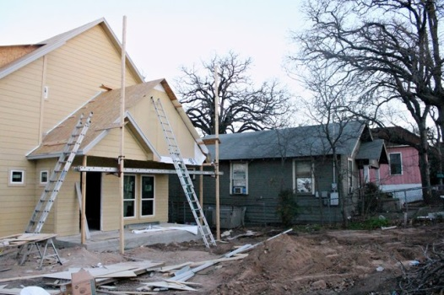
Issue: Entry into Neighborhood
A person may not:
For profit, persuade someone to sell or rent with representations regarding the entry or prospective entry into a certain neighborhood.
A/K/A “Blockbusting”
Examples: “The racial demographics of the neighborhood are undergoing changes in race, so sell now.”
Property taxes will go up when the national origin changes, sell now.”

Slide 31
Issue: Brokerage Services, Loans and Other Financial Assistance
Brokerage Services:
Set different fees for access to or membership in a multiple listing service (MLS)
Deny or limited benefits accruing to members in a real estate brokers’ organization
Impose different standards or criteria for membership in a real estate sales or rental organization
Establish geographic boundaries for access, membership or participation in any multiple listing service
In lending and other financial assistance:
Refuse to provide a person
Loan or financial assistance availability
Application requirements
Provide information that is inaccurate or different
Determine the type of loan or financial assistance
Fix the amount, interest rate, duration, etc.
Use different practices in determining credit worthiness.
Example: “You have to pay a higher interest rate because people of your national origin are a higher credit risk.”

Slide 32
Issue: Retaliation, Interference, Coercion, Intimidation
Under the Texas Workforce Commission Fair Housing Rules, someone cannot:
Interfere with an individual in their enjoyment of a dwelling
Coerce a person
Threaten
Intimidate
Retaliate
*No exemptions apply*
Example:
“Assistant Manager, you are fired because you refuse to rent to only Americans.”
“You are evicted because you filed a fair housing complaint.”

Slide 33
Issue: Retaliation, Interference, Coercion, Intimidation
HUD’s Quid Pro Quo and Hostile Environment Harassment Rule
https://www.gpo.gov/fdsys/pkg/FR-2016-09-14/pdf/2016-21868.pdf
What is quid pro quo harassment?
An unwelcome request or demand to engage in conduct where submission to the request or demand, either explicitly or implicitly, is made a condition related to the sale, rental or availability of a dwelling; the terms, conditions, or privileges of the sale or rental, or the provision of services or facilities in connection therewith; or the availability, terms, or conditions of a residential real estate-related transaction.
What is hostile environment harassment?
Unwelcome conduct that is sufficiently severe or pervasive as to interfere with: the sale, rental or availability of a dwelling; the terms, conditions, or privileges of the sale or rental, or the provision of services or facilities in connection therewith; or the availability, terms, or conditions of a residential real estate-related transaction.

Slide 34
Issue: Retaliation, Interference, Coercion, Intimidation
HUD’s Quid Pro Quo and Hostile Environment Harassment Rule
Direct liability
Own Conduct
Failing to take action on employee or agent
Failing to take action on third party
Vicarious liability
A person is vicariously liable for a discriminatory housing practice by the person’s agent or employee, regardless of whether the person knew or should have known of the conduct that resulted in a discriminatory housing practice, consistent with agency law.
Notes: Title VII affirmative defense does not apply to housing cases, and, for purposes of determining liability, prompt action to correct and end the discriminatory housing practice may not include any action that penalizes or harms the aggrieved person, such as eviction of the aggrieved person.

Slide 35
Disparate Impact: Other HUD Guidance
HUD’s Fair Housing Act’s Discriminatory Effects (Disparate Impact) Standard http://portal.hud.gov/hudportal/documents/huddoc?id=discriminatoryeffectrule.pdf
Discriminatory Effect (Disparate Impact) Defined:
Facially neutral practice
Actually or predictably results in a discriminatory effect on a group of persons protected by the Act (that is, has a disparate impact),
Or on the community as a whole on the basis of a protected characteristic (perpetuation of segregation).
Elements of Proof:
Charging party or plaintiff first bears the burden of proving its prima facie case that a practice results in, or would predictably result in, a discriminatory effect on the basis of a protected characteristic.
The burden then shifts to the respondent or defendant to prove that the practice is necessary to achieving a "substantial, legitimate, nondiscriminatory" interest.
Standard for justifying a practice is not to be interpreted more leniently than a "business necessity" standard.
If the respondent or defendant satisfies this burden, then the charging party or plaintiff may still establish liability by proving that the substantial, legitimate, nondiscriminatory interest could be served by a practice that has a less discriminatory effect.

Slide 36
Disparate Impact: Other HUD Guidance
HUD’s Fair Housing Act’s Discriminatory Effects (Disparate Impact) Standard
Policies and Practices that May have Discriminatory Effects (Disparate Impact)
Enacting or implementing land-use rules, ordinances, policies, or procedures that restrict or deny housing opportunities or otherwise make unavailable or deny dwellings
Provision of loans and other financial assistance
Community’s occupancy limit of X persons per dwelling
Criminal history
Limited English Proficiency (LEP)
Disturbance Policies

Slide 37
Fair Housing Act, Use of Criminal Records
100 million US adults, or 1/3 of the population have a criminal record of some sort.
Nationally, racial & ethnic minorities face disproportionately high rates of arrest and incarceration.
650,000 individuals are annually released from federal and state prisons
The ability to access safe, secure and affordable housing is critical to their successful reentry to society.
Criminal records-based barriers to housing may have a disproportionate impact on minority housing seekers
HUD Guidance, Application of Fair Housing Act Standards to the Use of Criminal Records by Providers of Housing and Real Estate-Related Transactions: http://portal.hud.gov/hudportal/documents/huddoc?id=HUD_OGCGuidAppFHAStandCR.pdf

Slide 38
Fair Housing Act, Excluding Individuals with Prior Arrests
A housing provider with a policy or practice of excluding individuals because of one or more prior arrests (without any conviction) cannot satisfy its burden of showing that such policy or practice is necessary to achieve a substantial, legitimate, nondiscriminatory interest.
A housing provider who denies housing to persons on the basis of arrests not resulting in conviction cannot prove that the exclusion actually assists in protecting resident safety and/or property.

Slide 39
Fair Housing Act, Excluding Individuals with Prior Arrests
Excluding individuals with prior convictions
A housing provider that imposes a blanket prohibition on any person with any conviction record – no matter when the conviction occurred, what the underlying conduct entailed, or what the convicted person has done since then – will be unable to meet this burden.
Must be based on a case-by-case basis
HUD Guidance, Application of Fair Housing Act Standards to the Use of Criminal Records by Providers of Housing and Real Estate-Related Transactions: http://portal.hud.gov/hudportal/documents/huddoc?id=HUD_OGCGuidAppFHAStandCR.pdf

Slide 40
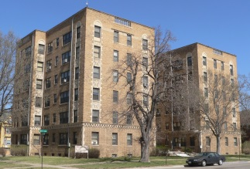
Disparate Impact: Fair Housing, Use of Criminal Records
Fair Housing Guidance on the Use of Criminal Records
Evaluating Whether the Challenged Policy or Practice is Necessary to Achieve a Substantial, Legitimate, Nondiscriminatory Interest
When using prior arrest instead of conviction, or using prior convictions, a housing provider must show that its policy accurately distinguishes between criminal conduct that indicates a demonstrable risk to resident safety and/or property and criminal conduct that does not.
Policies should take into account the nature and severity of the conviction and amount of time that has passed.
Other factors to consider: The facts or circumstances surrounding the criminal conduct; the age of the individual at the time of the conduct; evidence that the individual has maintained a good tenant history before and/or after the conviction or conduct; and evidence of rehabilitation efforts.
Blanket bans will not be able to meet this burden.
No ex-offenders allowed!

Slide 41
Disparate Impact: Other HUD Guidance
Limited English Proficiency (LEP) http://portal.hud.gov/hudportal/documents/huddoc?id=lepmemo091516.pdf refers to a person’s limited ability to read, write, speak, or understand English
Discrimination includes discrimination because an individual has the physical, cultural, or linguistic characteristics of persons from a foreign geographic area.
A housing provider violates the Fair Housing Act if the provider uses a person’s LEP to discriminate intentionally because of race, national origin, or another protected characteristic.
A housing provider also violates the Fair Housing Act when the provider’s policy or practice has an unjustified discriminatory effect, even when the provider had no intent to discriminate.
Local Nuisance and Crime-Free Housing Ordinances http://portal.hud.gov/hudportal/documents/huddoc?id=FinalNuisanceOrdGdnce.pdf
Labeled various types of conduct associated with a property—whether the conduct is by a resident, guest or other person, may include:
Victims of Domestic Violence.
Other Crime Victims.
Those Who Require Police or Emergency Services.

Slide 42
Exemptions: Sales and Rentals
The sale or rental of a single family house may be exempt from application of the Fair Housing Acts, if the owner:
does not own three or more properties
does not own any interest in the proceeds from the sale or rental of more than three single-family houses at any one time (applies if owner has only one sale or rental in a 24-month period, and the owner was not the most recent resident of the house at the time of the sale or rental)
does not use sales or rental facilities or services of a licensed broker, agent, or salesperson
does not publish, post, or mail (discriminatory statement) about the sale or rental that indicates a preference or limitation based on protected class
Owner may be exempt in the sale or rental of the rooms or units in a dwelling occupied, or intended to be occupied by not more than four families if the owner maintains or occupies one of the living quarters as his or her residence.
Note: These exemptions are not available if an owner makes a discriminatory statement, notice or advertisement or engages in intimidation, interference, coercion, retaliation or harassment.

Slide 43
Other Exemptions
Religious organizations
A private club that is not open to the public
A person engaged in the business of providing real property appraisals

Slide 44
Exemptions: Housing for the Elderly
Housing for elderly is exempt from the covered or protected class of familial status if the Commission determines the property is specifically:
Designed and operated to assist elderly individual under a federal or state program;
Intended for and solely occupied by individuals 62 years old or older; or
Intended for and 80% of the units are occupied by at least one individual 55 years of age or older for each unit.

Slide 45
Fair Housing Testing
In short, testing refers to the investigative tool of using individuals who, without any bona fide intent to rent or purchase a home, apartment, or other dwelling, pose as prospective buyers or renters of real estate for the purpose of gathering information; this information may indicate whether a housing provider is complying with fair housing laws.

Slide 46
Why is Testing Done?
To gather information (evidence) regarding the manner in which housing providers do business regarding:
Availability
Qualification Standards
Design and Construction Compliance
Treatment of home seekers
Discriminatory statements
Patterns or behaviors to corroborate or refute the experience of Complainant

Slide 47
Why is Testing Done?
Testing investigations often provide the evidence that is needed by victims of housing discrimination to meaningfully pursue a complaint, suit or administrative hearing.
Testing can uncover and/or support systemic forms of housing discrimination that persist in harming individuals and communities.

Slide 48
Testing Evidence May Show
That a respondent's defense is pretextual
Discriminatory basis for actions
That false statements have been made
That a unit was available on a particular date
That steering or redlining has taken place
That people of protected groups have been treated differently than others
That a requested accommodation or modification has been denied although reasonable
That a property does not comply with the accessibility requirements of the Fair Housing Act or Texas Fair Housing Act or local law
That loans or insurance are available to people of protected groups on different and unfavorable terms than made available to people in other groups

Slide 49
Testing – How it Works
Testing is often done by pairing together two individuals who are as similar as possible in all characteristics including similar financial profiles, but who differ when it comes to the protected class involved.
For example, one member of a pair might use a wheelchair while the other person has no noticeable mobility impairment.
For example, one member of a pair might have a light skin tone, while the other person has a darker skin tone.
They each separately visit (or call/email) the site of a housing provider (within an appointed time period) and inquire about the availability of housing.

Slide 50
Testing – How it Works
Afterwards, the testers objectively record in detail everything that happened during the test — what was said, what was offered, what price was quoted for an available apartment, etc.
A test coordinator compares each of the testers’ objective reports to determine whether a difference in treatment based on the protected class may have occurred.

Slide 51
Testing Settings
Testing can be applied in settings other than rental activities, including real estate services, home insurance, mortgage lending offices, and appraisal of housing.
A specific test is designed based upon specific bases, or protected classes — race or color, national origin, religion, sex, familial status, and disability.

Slide 52
Testing Disparities
The most straightforward differences in the treatment of the two testers in a rental scenario is the property saying a unit is just not available to the person with the protected class
Many other manifestations:
Shown units in less desirable parts of the property
Property management staff being unavailable to assist
When the unit might be available
What is required to apply, terms and conditions
Number and type of units shown
Move in specials offered (or not offered)
Amount of rent

Slide 53
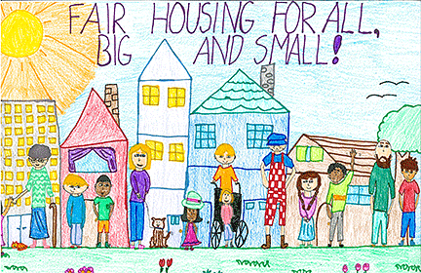
Most Common Testing Models
Disability status
Families with children
Color

Slide 54
Fair Housing Testing - HUD
HUD funds fair housing organizations and other non-profits through the Fair Housing Initiatives Program (“FHIP”) who assist people who believe they have been victims of housing discrimination.
FHIP organizations partner with HUD to help people identify government agencies that handle complaints of housing discrimination.
They also conduct preliminary investigation of claims, including sending "testers" to properties suspected of practicing housing discrimination.

Slide 55
What Properties Can do to Prepare for Testing
Because testers don't identify themselves, presume any contact a property receives could be a potential tester.
The best strategy is to be informed and have staff well trained on fair housing laws and be sure to reflect this careful outlook on the way you interact with all prospects.
If all prospects are treated equally as if they may be testers, you'll help ensure you don't violate fair housing law, which is a risk with real prospects as well as testers.

Slide 56
Complaints
If you have a complaint filed against you:
You will be notified of the allegations
You likely will be invited to mediate
If you decide not to mediate, you may file an answer that is
In writing
Under penalty of perjury
May be amended at any time
If you need to file a complaint:
Go to: texasworkforce.org/civil rights
Fill out Form and submit by email, fax or mail

Slide 57
Mediation
Free service offered from the time of the complainant filing until resolved
Eliminates lengthy investigations and expensive litigation
Speedy resolution of complaints
Saves time and money
Opens lines of communication between disputing parties
Allows each party to understand the position of an opposing party
The agreement is binding on both the Complainant and the Respondent

Slide 58
Training & Technical Assistance
Contact the Texas Workforce Commission, Civil Rights Division at
(888) 452-4778 or (512) 463-2642
crdtraining@twc.state.tx.us

Slide 59
Questions?
Please sign up for the Civil Rights Reporter at:
http://www.twc.state.tx.us/partners/civil-rights-reporter

